Slide 1
Web Technologies
Lecture Week Three
Getting Started with CSS 3

Slide 2
This week’s agenda
Media Queries
Understanding Mobile first approach
Making your website responsive using media queries

Slide 3
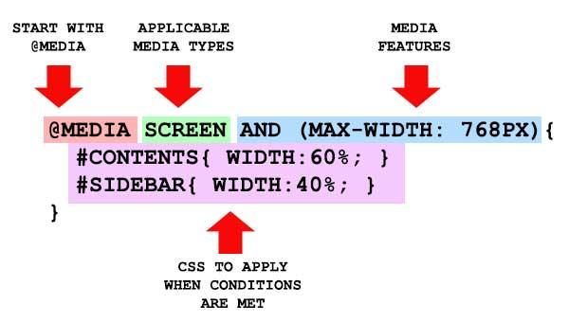

Slide 4
Media Queries…
Media Query is a technique introduced in CSS3.
It use the @media rule to include a block of CSS properties only if a certain condition is true.
For mobile viewports to support media queries, you will require to include a <meta> tag in the <head> element.
<meta name="viewport" content="width=device-width, initial-scale=1">
@media only screen and (max-width: 600px) {
body {
background-color: lightblue;
}
}

Slide 5
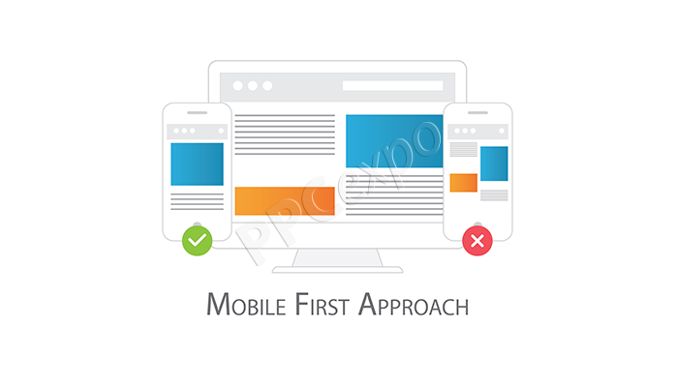

Slide 6
Mobile First Approach…
Mobile First, as the name suggests, means that we start the design from the mobile end.
The mobile-end has more restrictions on the design.
Gradually expand its features to create a tablet and desktop version.
While writing styles for mobile first approach. We start with designing for mobile version then use media queries to target larger devices.

Slide 7
Mobile First Approach
.container{
width: 100%;
max-width: 450px;
margin: 0 auto;
padding: 0 15px;
}
@media screen and (min-width: 560px){
.container{
max-width: 530px;
}
}
@media screen and (min-width: 728px){
.container{
max-width: 700px;
}
}

Slide 8
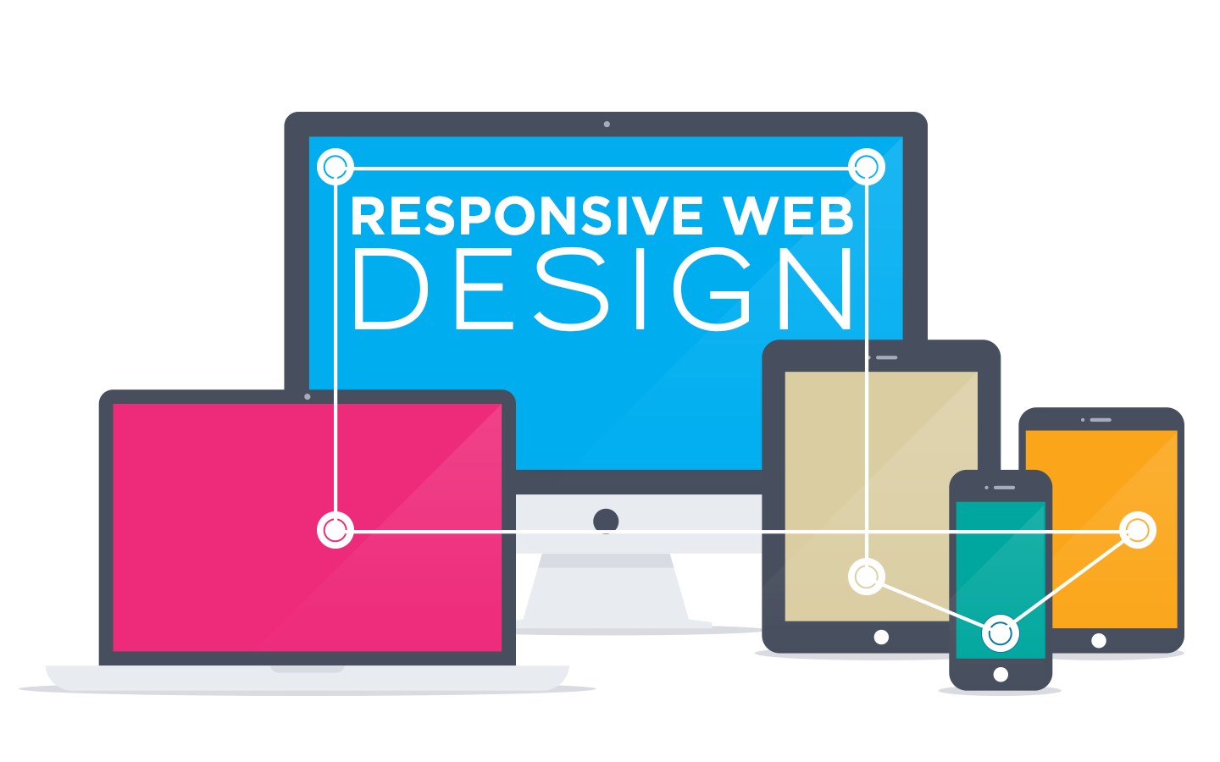

Slide 9
Responsive Web Design…
Responsive web design is an approach of creating your desktop version application accessible to various smart devices.
With responsive design, we cut out the unnecessary elements or shrink the design to fit to the device.
While writing styles for responsive web design. We start with designing for desktop version then use media queries to target smaller devices.

Slide 10

Responsive Web Design
.container{
width: 100%;
max-width: 1140px;
margin: 0 auto;
padding: 0 15px;
}
@media screen and (max-width: 728px){
.container{
max-width: 600px;
}
}
@media screen and (max-width: 630px){
.container{
max-width: 500px;
}
}

Slide 11
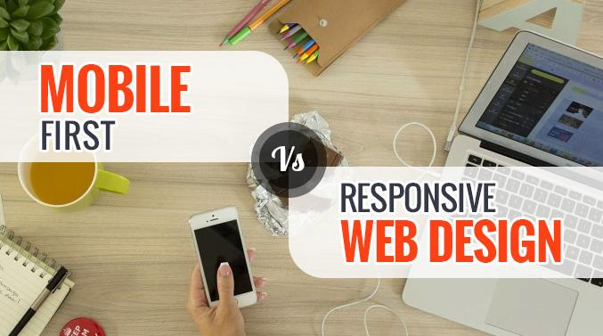



Slide 12
Mobile First Vs Responsive Design
Mobile First Design | Responsive Web Design
Minimalistic way of designing | Recommended by Google!
Can be leveraged and added more power in larger versions | Deliver better user experience for users using across devices
Faster to load and delivers flawless experience | Consistent brand experience
Idle for if your user base is widely based in mobile devices. | Idle for if your user base is widely based in desktop
The desktop versions are not readily available early | The mobile experience cannot be defined early

Slide 13
Mobile First Vs Responsive Design…
.container{
width: 100%;
max-width: 450px;
margin: 0 auto; padding: 0 15px; }
@media screen and (min-width: 560px){
.container{
max-width: 530px;
}
}
@media screen and (min-width: 728px){
.container{
max-width: 700px;
}
}
.container{
width: 100%;
max-width: 1140px;
margin: 0 auto; padding: 0 15px; }
@media screen and (max-width: 728px){
.container{
max-width: 600px;
}
}
@media screen and (max-width: 630px){
.container{
max-width: 500px;
}
}

Slide 14
Before you come for Lab, Research!!
Mozilla Developers Network: CSS
CSS: W3C Schools
CSS: Tutorial Points
CSS3: Tutorial Points
CSS Pseudo classes

Slide 15
Before you come for Lab, Research!!
Mobile First Approach
Responsive Web Design Breakpoints
Media Queries

Slide 16
Thank you!

